Slide 1
I-SEARCH
NOTECARDS

Slide 6
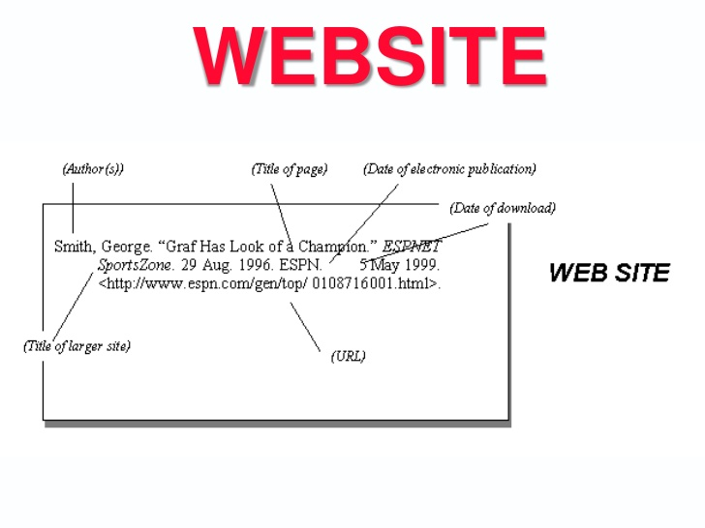

Slide 7
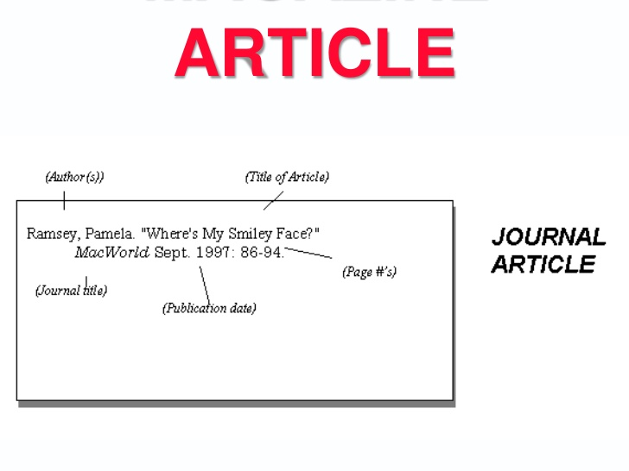

Slide 8
Include only one thought per card
Make sure you include only one thought per card.
Make sure you include only one thought per card.
Make sure you include only one thought per card.
(Do you get the idea that this is important?)

Slide 9
Make sure your paraphrases and summaries accurately reflect the ideas in your sources
If you copy word for word, make sure you use quotation marks and cite your source!
Refer back to your controlling idea (or thesis) often – only take notes on information that pertains to your thesis!
If it doesn’t pertain to your thesis, ditch it! (Or change your thesis…)

Slide 10
Works Cited
Landsberger, Joe. “Organizing Research: Creating Notecards.” Study Guides and Strategies. N.p., n.d. Web. 23 Apr. 2013.
“Paraphrasing.” BrainPOP, n.d. Web. 23 Apr. 2013.
The Purdue OWL Family of Sites. The Writing Lab and OWL at Purdue and Purdue U, 2008. Web. 23 Apr. 2008.

